Slide 1
Identifying Nashville’s Popular Pythonistas with NetworkX
November 16, 2017
Stephen Bailey

Slide 2

Notes:
* You're new to Nashville. You're ready to start meeting people, making friends, expanding your network. But you don't want to get pigeon-holed into just one group, i.e. the people you might already know / are comfortable with. Maybe you're trying to market yourself / a product.
* What groups should you join? Who should you talk to in those groups? Wouldn't you rather be invited into a group than just show up at one?

Slide 3
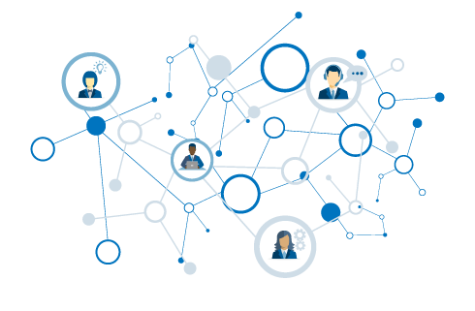
Popular Pythonistas
What is a network?
Using graphs
Ranking MeetUp groups
Ranking MeetUp people

Slide 4
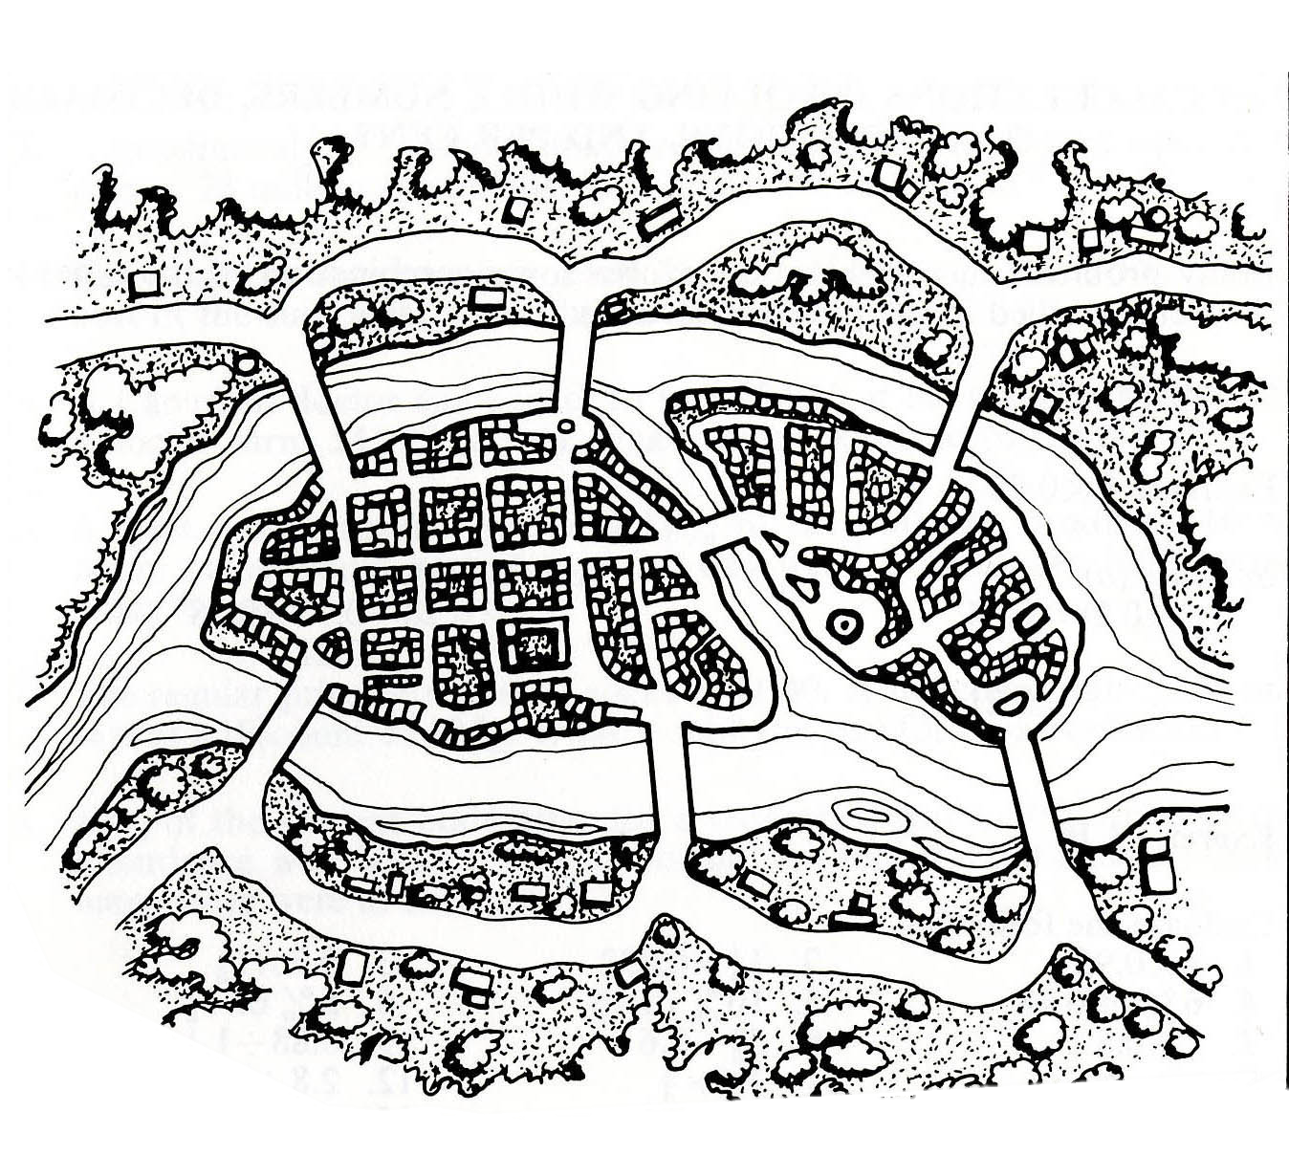
Can you traverse every bridge just once?
2
1
3
4
5
6
7

Slide 5
2
1
3
4
5
6
7

Slide 6
A
2
1
3
C
B
4
5
6
7
D

Slide 7
A
2
1
3
C
B
4
5
6
7
D

Slide 8
Graph
A
Node
B has the most connections
B
C
Edge
D
A & D are on the “outside” – they are not connected to each other
Notes:
Without knowing anything about this system, what is one thing you might say?
B seems to be the most “important” place – has the most connections.
B and C are seem to be more central to the graph – A and D are both on the edges

Slide 9
1
1
To travel into AND out of a node, requires 2 steps (or 4 or 6…).
Therefore… either:
All nodes are even.
Exactly two nodes are odd.
2
2
1
3
2
Notes:
Without knowing anything about this system, what is one thing you might say?
B seems to be the most “important” place – has the most connections.
B and C are seem to be more central to the graph – A and D are both on the edges

Slide 10
Four nodes with odd number of edges!
3
5
3
3
Notes:
Without knowing anything about this system, what is one thing you might say?
B seems to be the most “important” place – has the most connections.
B and C are seem to be more central to the graph – A and D are both on the edges

Slide 11
That’s the ticket…
3
4
3
2
Notes:
Without knowing anything about this system, what is one thing you might say?
B seems to be the most “important” place – has the most connections.
B and C are seem to be more central to the graph – A and D are both on the edges

Slide 12
Graphs
Useful for understanding relationships.
Describe structure of networks.

Slide 13
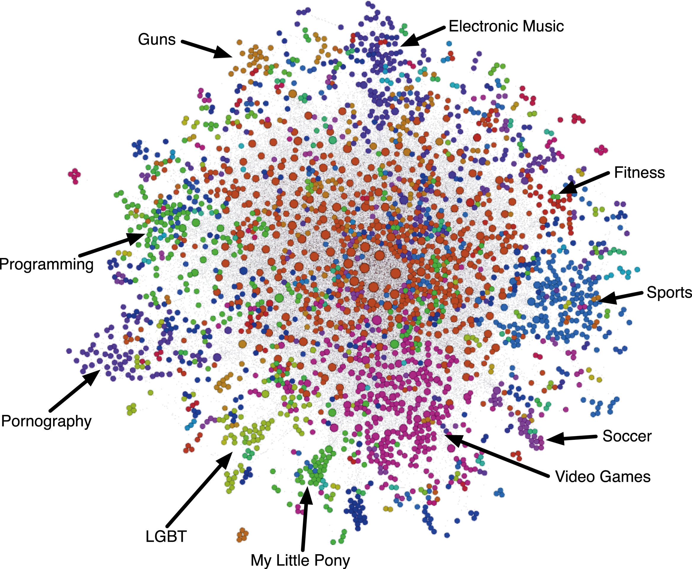
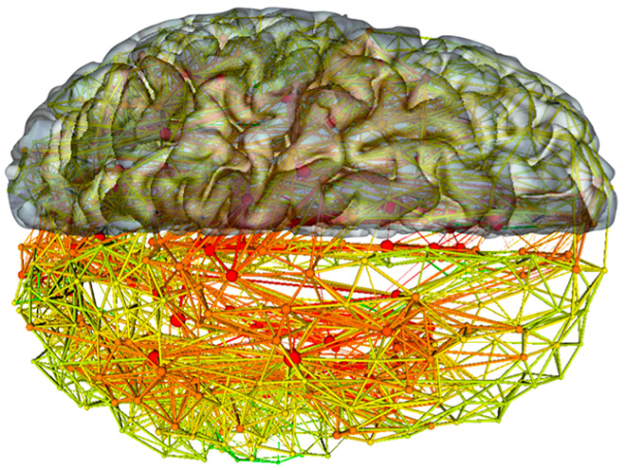
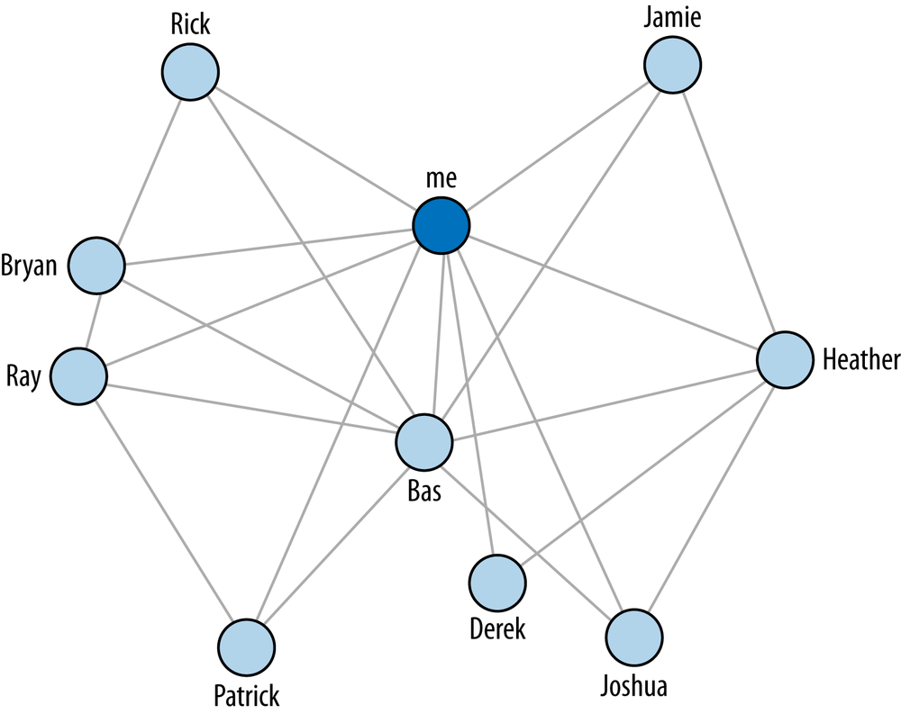
Notes:
Without knowing anything about this system, what is one thing you might say?
B seems to be the most “important” place – has the most connections.
B and C are seem to be more central to the graph – A and D are both on the edges

Slide 14
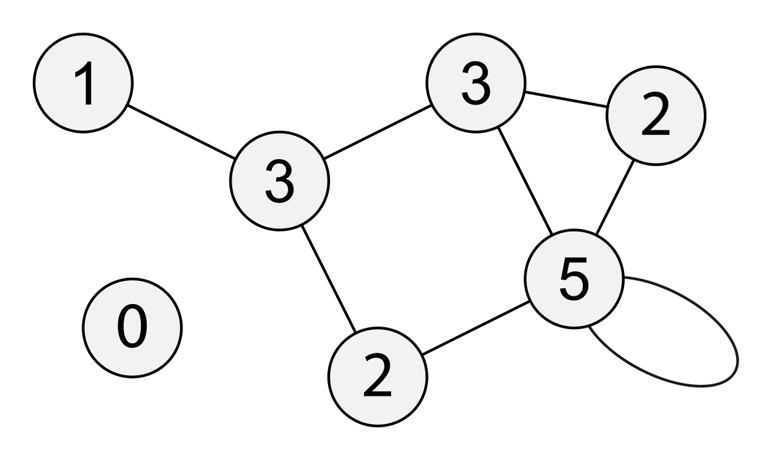
Degree
Path Length
Notes:
Path length – average

Slide 15
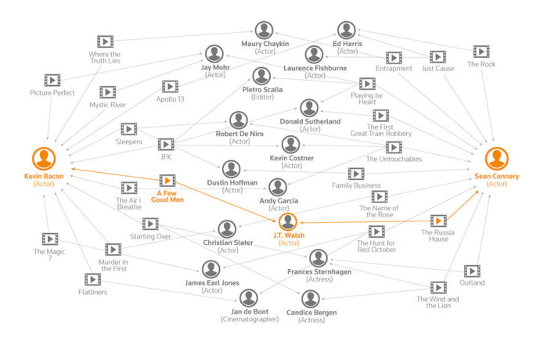

Slide 16
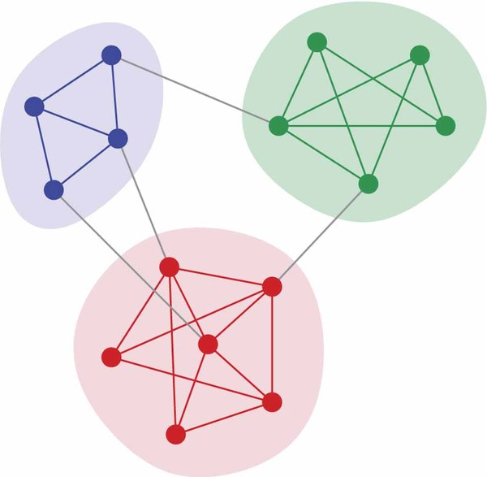
Clustering
Communities

Slide 17
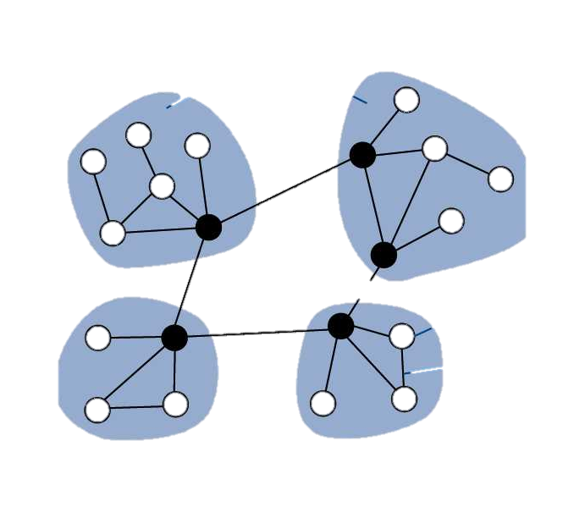
Hubs

Slide 18
Identifying a network problem
Good way to make sense of multivariate data
Centrality
Influence
Mapping
Recommendations

Slide 19
The MeetUp Data
Used MeetUp API to get the following information:
All groups within 25 miles of Nashville.
All members of those groups.
All events for each group and who RSVPed yes.
(On Github)

Slide 20
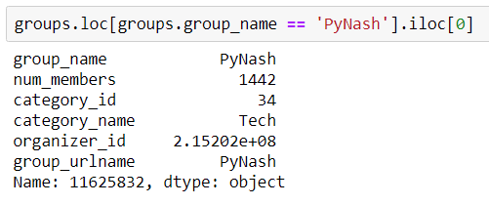
Analysis 1: PyNash Cliques?

Slide 21
PyNash Relationships
We have >1400 members. But not all of them come to every meeting. (And many don’t come to any meetings.)
So

Slide 22
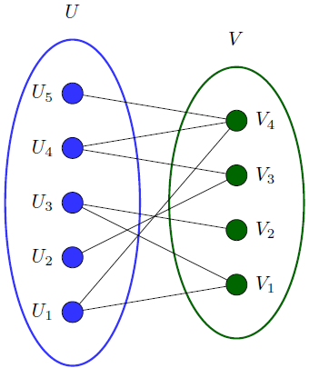
Bipartite Graphs
Great initial starting place for some datasets.
Can take the form of (Person node → Affiliation node)
e.g. (Sports fan → Sports team)

Slide 23
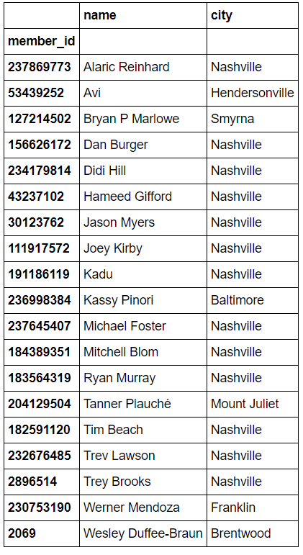

Slide 24
Bipartite Graphs
nx.graph()

